Slide 1
Capstone Project
Keith Castelino and Sourabh Gupta

Slide 2
Our study analyzes failure to appear and disposition time for King County Court
Current State
The King County Court system experiences delays driven by defendants failing to appear in court
Desired Future State
Defendants released on bail appear on time before judges, and time to disposition for cases is reduced
Methodology
Identifying causes of longer disposition time, failure to appear and it’s impact on disposition

Slide 3
Data Available
Case Data – records every case
Case Event Data – records of every event in a case
Charges Data – records of every charge associated with a case
Custody History – records of when defendants went into and out of custody
Criminal History – records of past criminal activity of defendants

Slide 4
EDA – show most important takeaway 1
One graph and text explanation (1-2 lines max) required

Slide 5
EDA – show most important takeaway 2
One graph and text explanation (1-2 lines max) required

Slide 6
EDA – show most important takeaway 3
One graph and text explanation (1-2 lines max) required

Slide 7
EDA – other points

Slide 8
Failure To Appear – Regression Approach
Logistic regression model here
One big graph . . . + . . . Text to explain

Slide 9
Failure To Appear – Tree Based Approach
Decision Tree
Tree graph . . . + . . . Text to explain

Slide 10
Disposition Time – Regression Approach
In addition to case events and charge traits, defendants’ immutable traits also have a relationship with disposition time

Slide 11
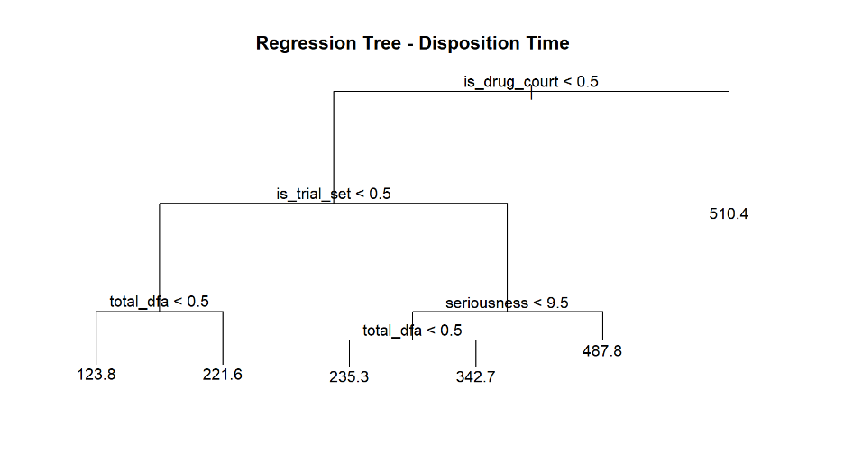
Disposition Time – Tree Based Approach
Case events and characteristic traits of the crime affect time to disposition of a case

Slide 12
Impact of Failure to Appear on Disposition
Logistic regression model here
One big graph . . . + . . . Text to explain

Slide 13
Impact of Failure to Appear on Disposition
Logistic regression model here
One big graph . . . + . . . Text to explain

Slide 14
Conclusions

